Slide 1
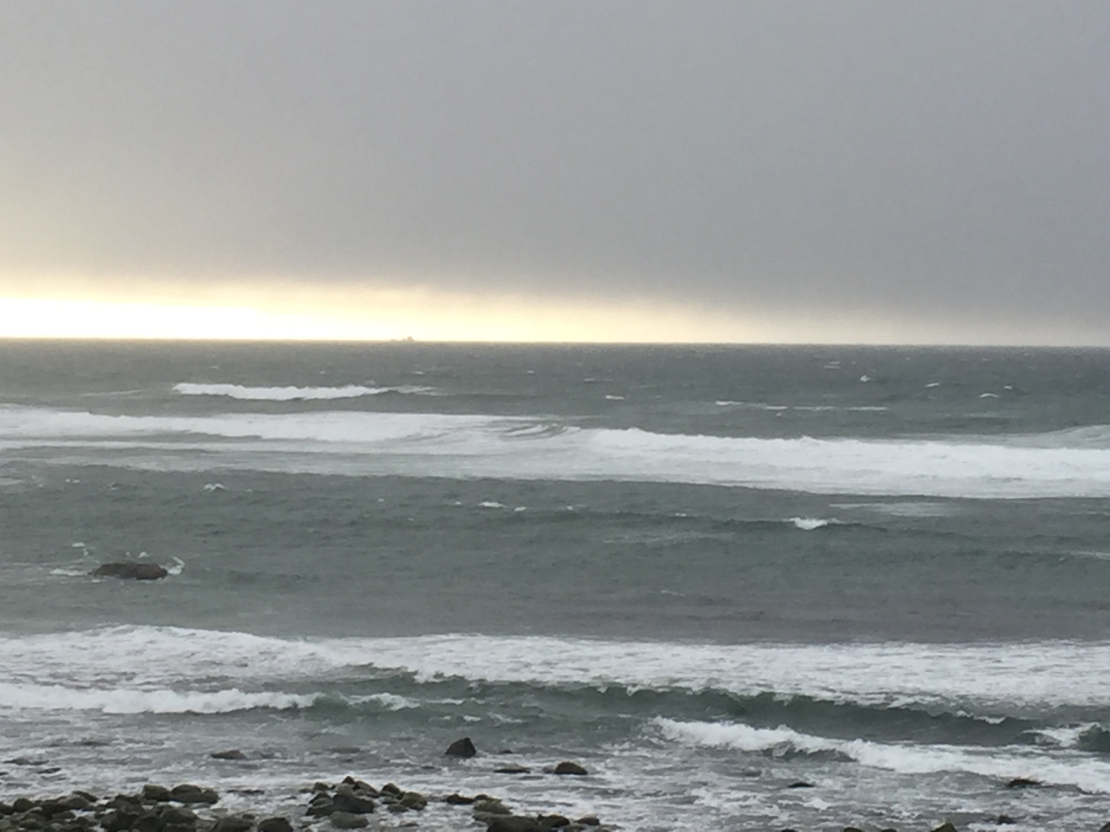
The Norwegian Petroleum History and Archives
–
Policies, Technology and Transition
Copyright: Arve Johnsen, ONS 1. september 2016

Slide 2
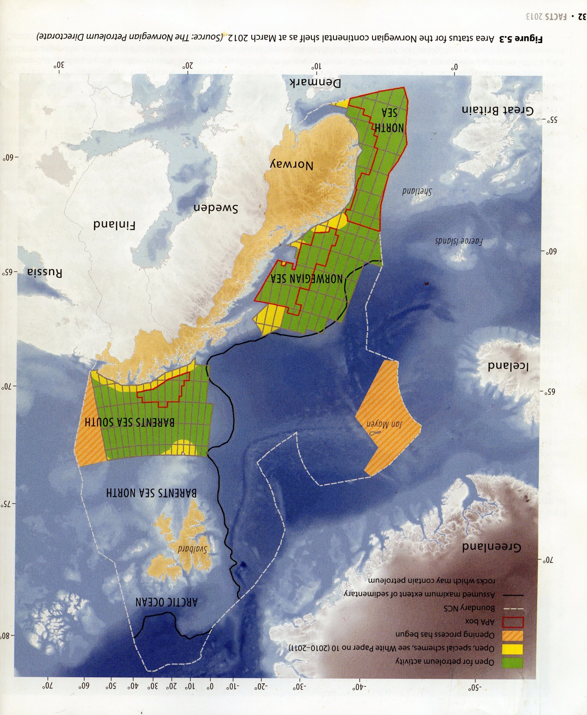

Slide 3
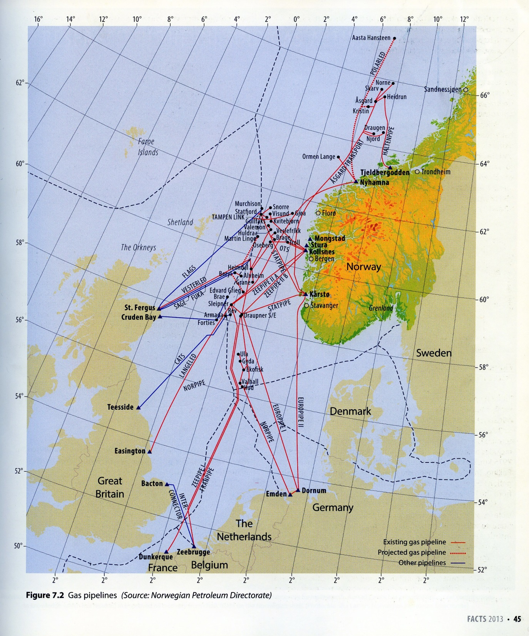

Slide 4
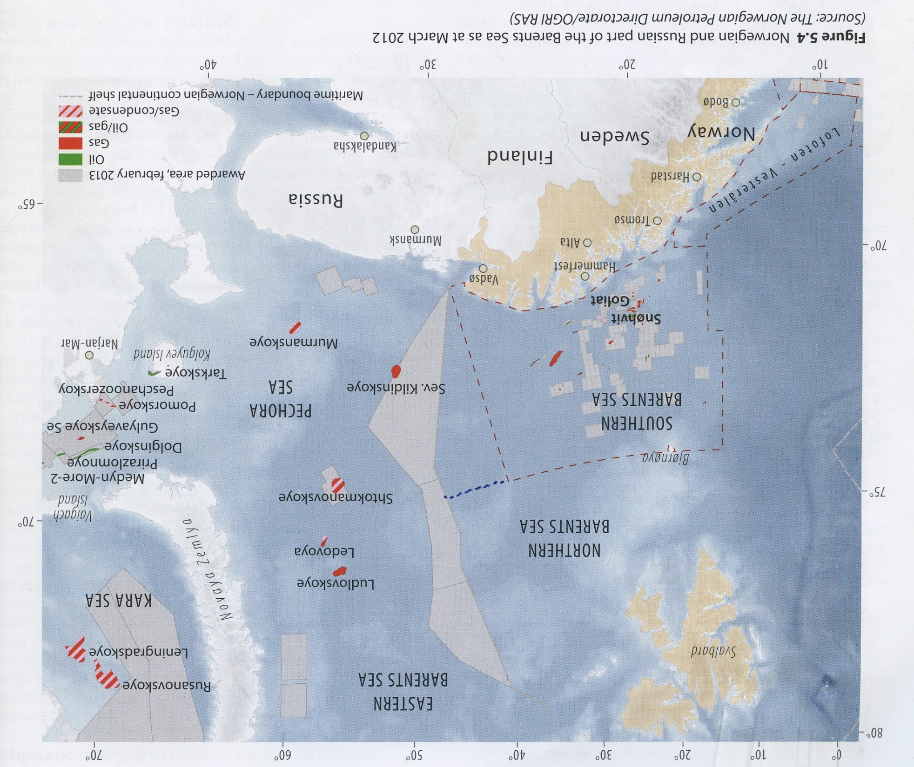

Slide 5
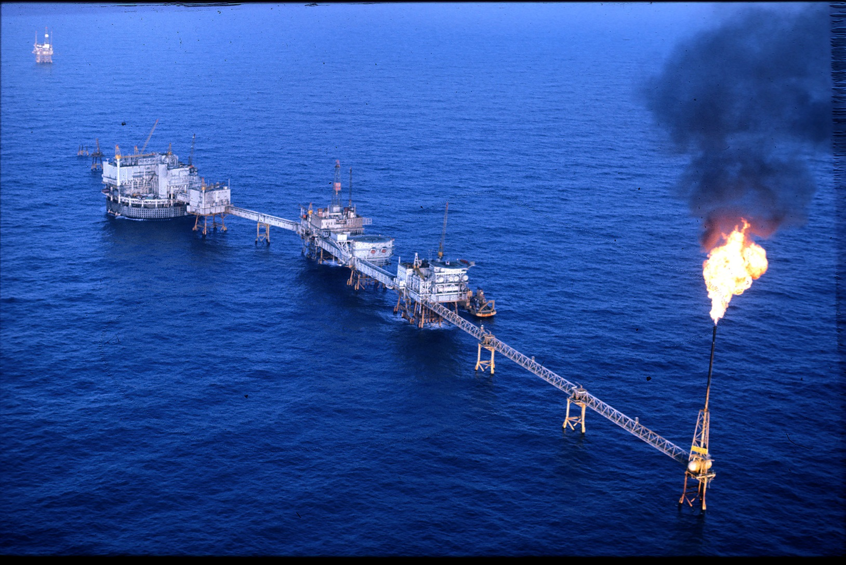
Ekofisk
Ekofisk, Foto: ConocoPhillips/Norsk Oljemuseum

Slide 6
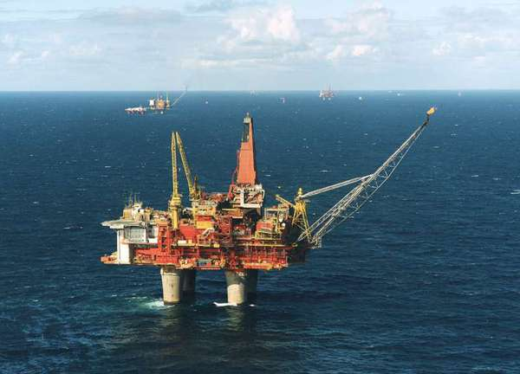
Statfjord A

Slide 7
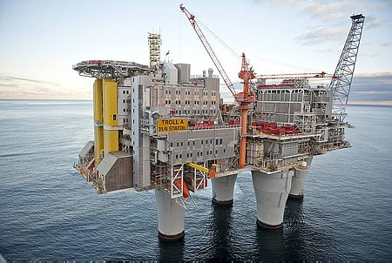
Troll
Foto hentet fra: http://www.offshoreenergytoday.com/wp-content/uploads/2012/08/ABB-Powers-Troll-A-Norway.jpg

Slide 8
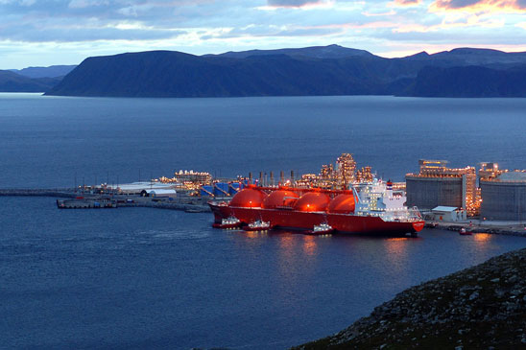
Snehvit
Kilde: http://www.statoil.com/no/OurOperations/ExplorationProd/ncs/snoehvit/Pages/default.aspx

