Slide 1
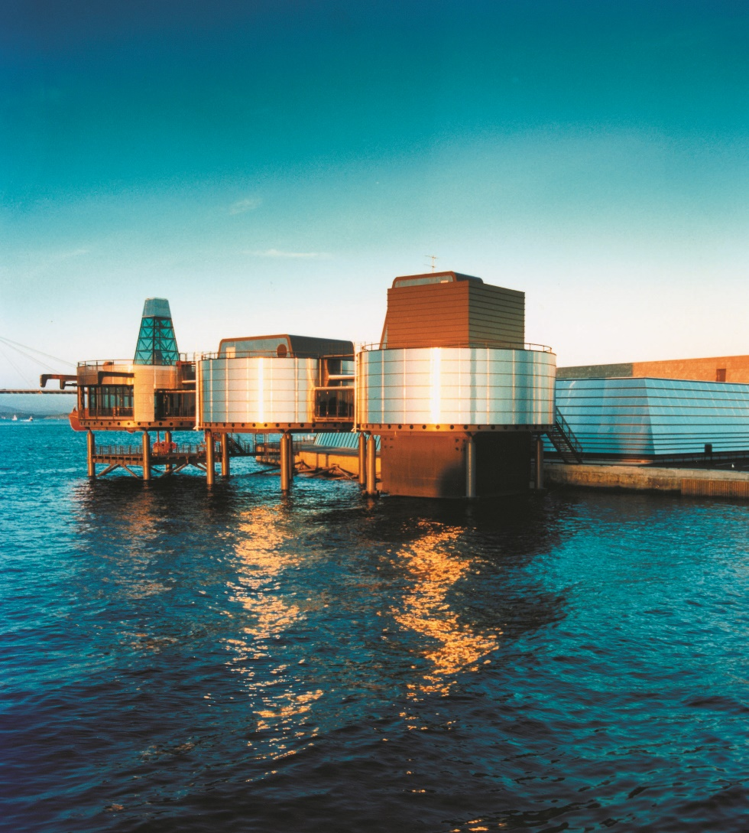
Industrial Heritage
How to document large technical-industrial monuments at sea.

Slide 2
The background
The environmental action plan for the petroleum sector produced by the Ministry of Petroleum and Energy in 1999 stated the necessity to ensure that important and historical structures were preserved and made accessible for future generations, as well as documenting the development of government administration.
In a March 2000 letter to several museums with interests relating to the offshore activities, the Norwegian Directorate for Cultural Heritage (NDCH) raised a challenge: “What cannot be preserved should be documented”.
Early in 2001 The Norwegian Petroleum Directorate (NPD) wrote a letter to the operator of the Ekofisk field urging Philips Petroleum to initiate a study of how such a documentation project could be done, and indicating that the Norwegian Petroleum Museum (NPM) was best fit to perform the task. Within a fortnight Philips Petroleum accepted the challenge, and the Petroleum museum delivered a preliminary report by early October.

Slide 3
Plans and Priorities
How did NPM select which of the many fields to document?
The first two, Ekofisk and Frigg, were the obvious candidates. Ekofisk was the very first oil producing field on the Norwegian continental shelf, while Frigg was a major gas field on the border to Great Britain and an important supplier of natural gas to British homes, soon to be totally decommissioned.
The joint Norwegian and British ownership of the Frigg field made it of particular interest and allowed for collaboration with the University of Aberdeen on the documentation project

Slide 4
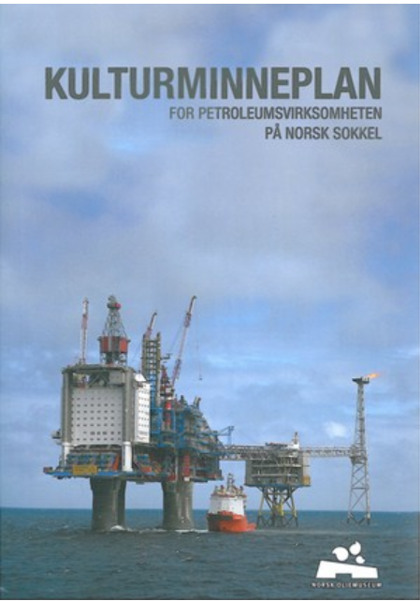
A national industrial heritage plan
A steering and reference group consisting of ten people with outstanding experience from many different aspects of the oil industry and some with professional museum/historical background.
Selection criteria for choosing facilities to be defined as industrial heritage monuments.
  Installations representing different development eras
  The first, most important or most representative technology
  Illustrating the breadth in development solutions or platform types
  Special projects (i.e. CO₂ removal, sub surface production satellite fields)
  Unique in a Norwegian or international context
  Economic significance
  Social significance
  Special historical incidents associated with the installations
  Political decisions and debate over the development
A-list
  Ekofisk area (project completed 2004)
  Frigg area (project completed 2008)
  Oseberg area
  Snøhvit
  Statfjord area (project completed 2012)
  Troll area
  Valhall area (project completed 2015)
  Åsgard area

Slide 5
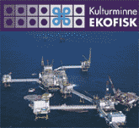



Documentation projects
Industrial Heritage Ekofisk –
(2002-2005)
Industrial Heritage Frigg
(2005-2008)
Industrial Heritage Statfjord
(2008-2012)
Industrial Heritage Valhall
  (20013-2015)

Slide 6
Ekofisk - What to document?
14 of 30 platforms were due to be removed up to 2013
It was necessary to make a selection
Only one or two of the platforms with similar functions in the production process was selected
1 production platform, 1 pump platform, 2 combined production and living quarters, 1 concrete platform, 1 hotel platform

Slide 7
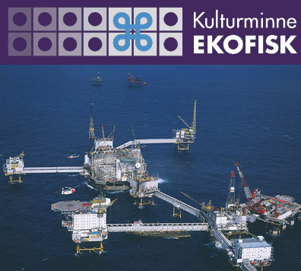
The Ekofisk Industrial Heritage website
www.kulturminne-ekofisk.no
Provides an insight into the development of the Ekofisk area in the Norwegian North Sea from 1962 - 1998

Slide 8

http://www.kulturminne-frigg.no/

Slide 9
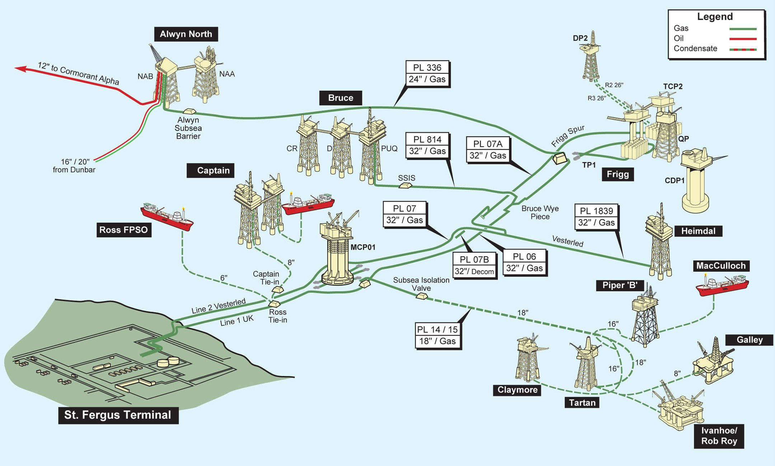

Slide 10
Films
100 films from Ekofisk
50 films from Frigg
The Norwegian National Library have digitized the films and registered the metadata in Mavis
Real Player or Flash are used to show the films on Internet

Slide 11
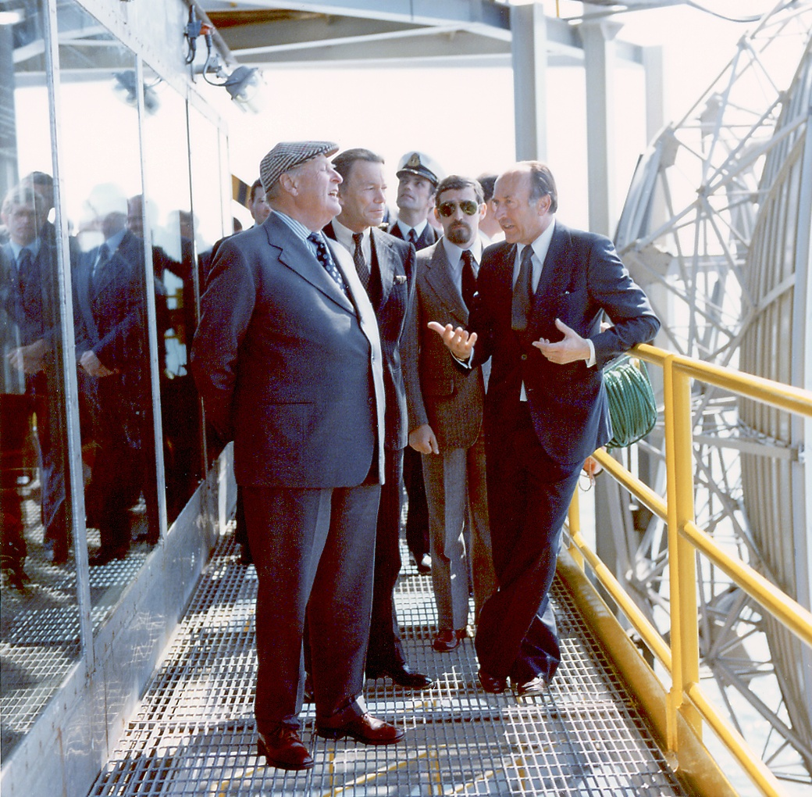

Slide 12
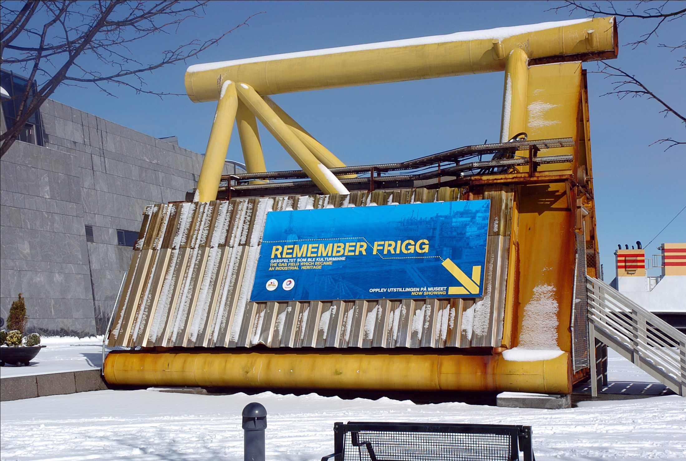

Slide 13
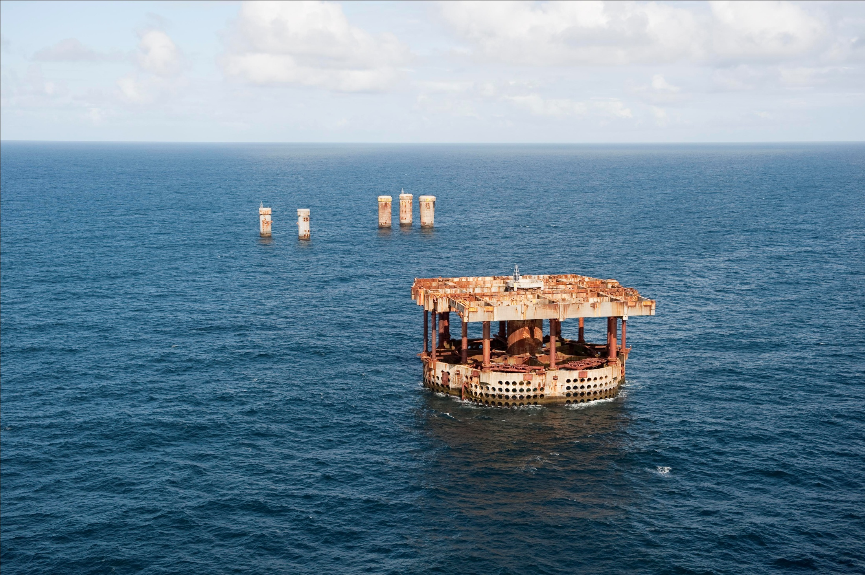

Slide 14
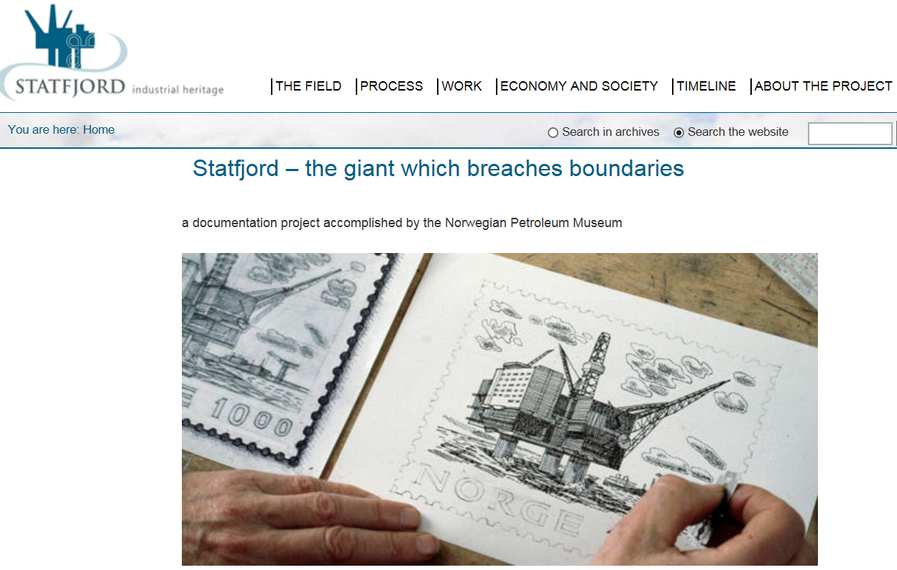
http://www.kulturminne-statfjord.no/

Slide 15
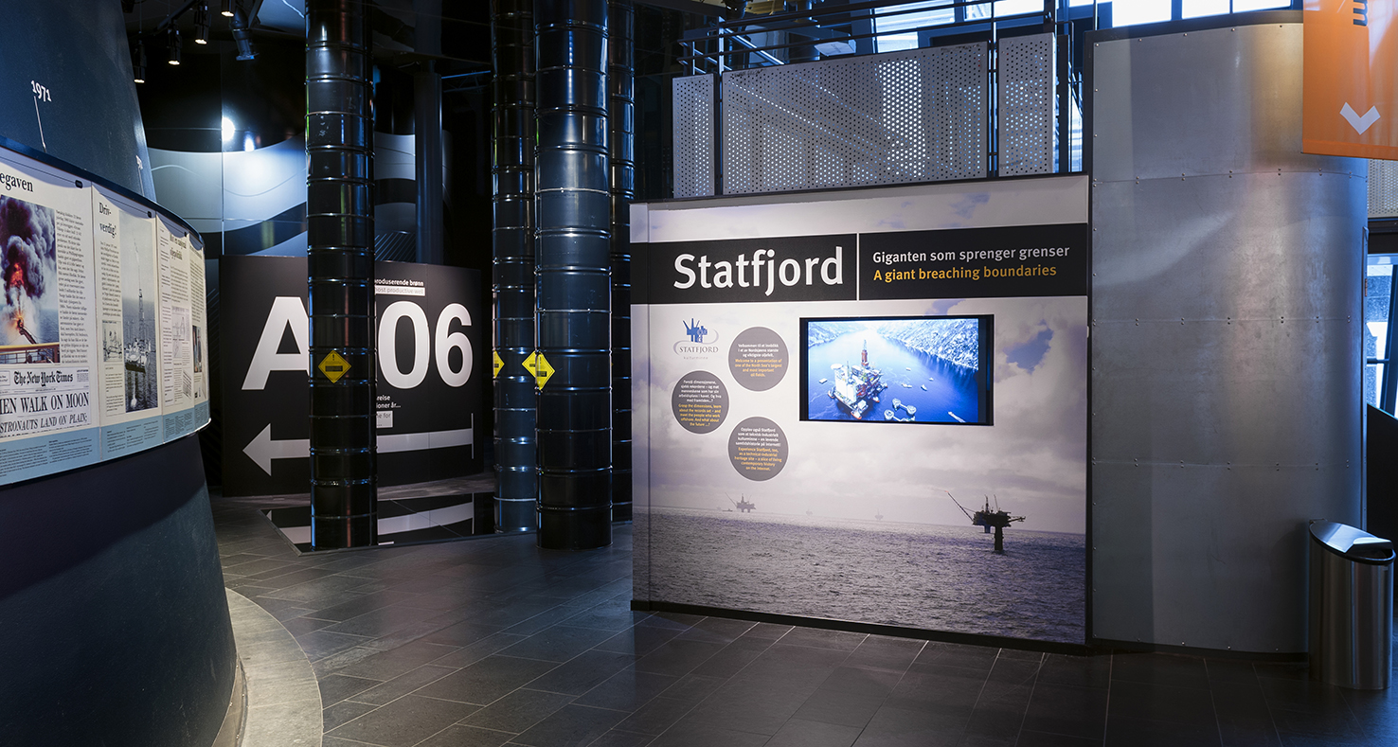
Exhibitions also

Slide 16
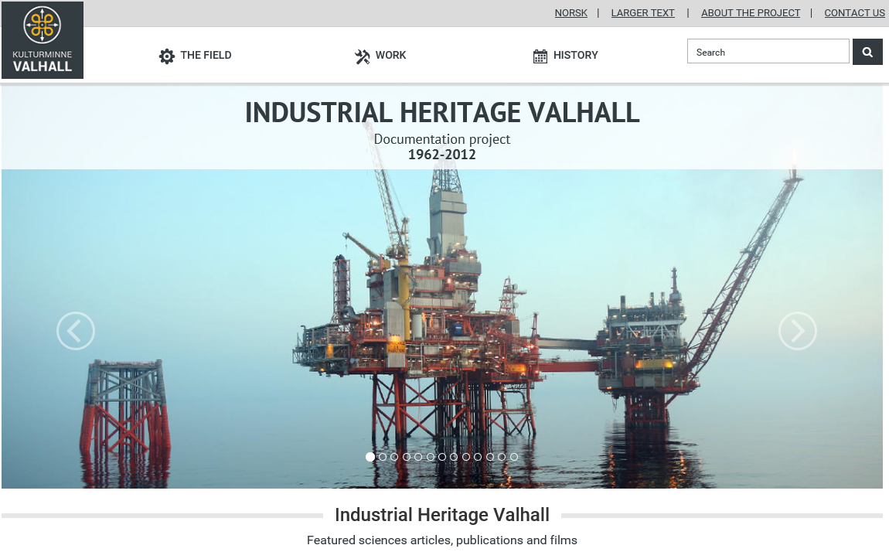
http://www.kulturminne-valhall.no/eng/
Notes:
Industrial Heritage Valhall was launched in December 2015

Slide 17
Valhall has its own place in the museum

Slide 18

I can’t do what you do and you can’t do what I do, but together we can make success

Slide 19
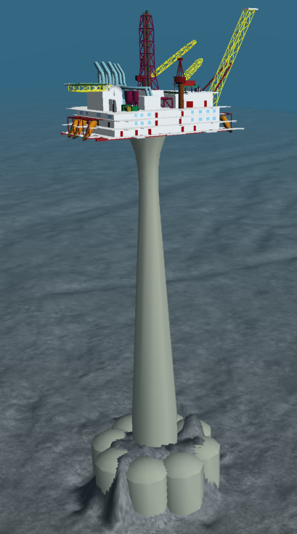
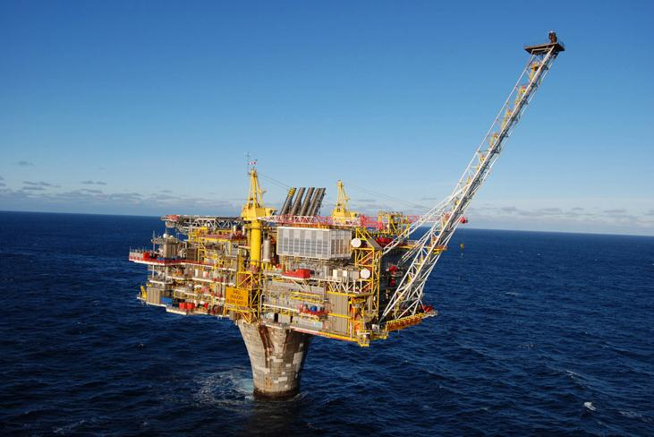
And then there will be Draugen
Notes:
Approved for construction and operation in December 1988 as the first platform north of the 62th latitude. In operation from October 1993. The Industrial Heritage website will be launched late in 2018.

Slide 20
Methodology for executing the project
The Norwegian Petroleum Museum, in cooperation with the Directorate for Cultural Heritage has developed a methodology and a model for documenting cultural heritage in the oil and gas sector.
The museum will execute the project in close cooperation with the National Library of Norway and the National Archives in Stavanger.
A basic structure has been developed for storing, preserving and retrieving source documents.
An internet-based solution for presenting materials has been developed in cooperation with a web company.
Experience shows that carrying out the work while the field is still in operation will be crucial for the quality of the project.

